Slide 1
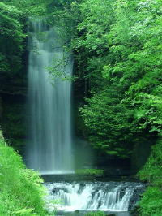
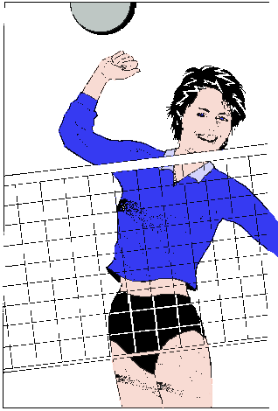
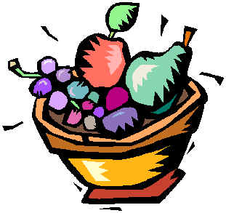
Personal Development
L13 Stress Management
Tutor: Yipsir
www.yipsir.com.hk

Slide 2
By the end of the Workshop…
You will be able to:
  Define stress
  Identify the different types of stress
  Understand how stress effects the body
  Name and practice a few stress management techniques

Slide 3
Stress at Work and Study
Today’s work environment is increasingly characterized by heavier work loads, longer work hours, fewer resources, more ambiguities, and less job security.
Most of the workers in Hong Kong characterize their jobs as highly stressful.
Like wisely, college students, for one reason or other, do face substantial study pressure.

Slide 4
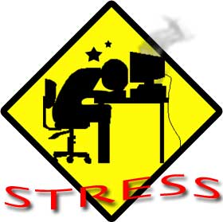

What is Stress?
Stress is the body’s psychological, emotional, and physiological response to any demand that is perceived as threatening to a person’s well-being.

Slide 5

What is Stress?
Stress a psychological and physiological response to events that upset our personal balance in some way.
These events or demands are known as stressors.
Some stressors include:
  Work
  School
  Parents/children
  Friends

Slide 6
S = D > A
Stress occurs when the Demand is greater than your Ability.

Slide 7
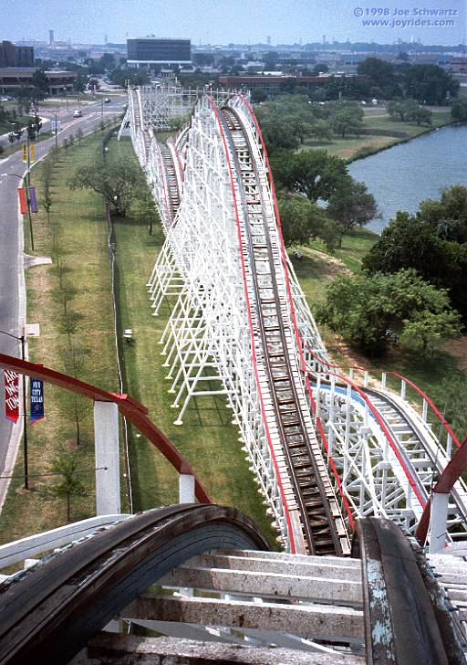
Types of Stress
Eustress can be defined as stress that is healthy, positive and gives one a feeling of fulfillment. It occurs when your level of stress is high enough to motivate you to move into action to get things accomplished.
  Meeting a challenge
  Coming in first or winning
  Getting a promotion
  Marriage
  The holidays
  Buying a new home
  Going on a roller coaster ride

Slide 8
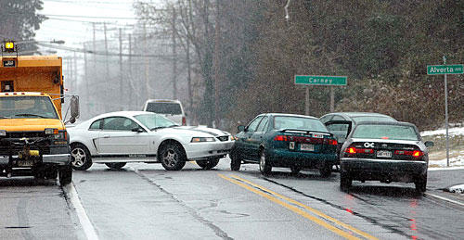
Types of Stress
Distress is negative stress caused by adverse events. It occurs when your level of stress is either too high or too low and your body and/or mind begin to respond negatively to the stressors.
  Breaking up with a boyfriend
  Wrecking your car
  Losing your job
  Losing a loved one
  Ruining a new pair of shoes

Slide 9
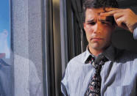
How Stress Effects Your Body
Stress is one of the major causes of all illnesses.
Some common illnesses include:
  Migraines (偏頭痛)
  Dizziness (頭昏眼花)
  Acne (粉刺)
  Upset stomach
  Elevated blood pressure
  Irritability (易怒, 過敏)
  Chest pain

Slide 10
How Stress Effects Your Body
Prolonged or Chronic stress can cause many health complications such as:
  Strain (拉緊) on the heart
  Damage to memory cells in the brain
  Deposit of fat at the waist rather than the hips and buttocks (a risk factor for heart disease, cancer and other illnesses)
  Ulcers

Slide 11
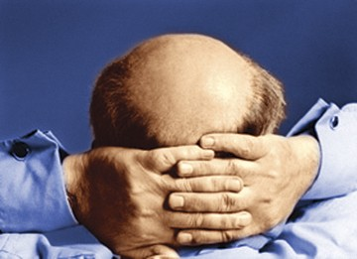
Other Complications
Hair loss
Gray hair
Depression
Appearance of aging
Weakened immune system (making even a head cold difficult to fight off)

Slide 12
心理身體緊張鬆弛測試表
（PSTR）

Slide 13
Score | Pressure | Effect 影響 | Advice 建議
(98) 93以上 | Extreme 極度 | Health is already damaged 已損害健康 | Looking for psychological guidance 尋求心理輔導
(76) 71-81 | Medium 中等 | Start to affect the Health 開始影響健康 | Doing exercises for Relaxing muscles 肌肉鬆弛練習
(65) 60-70 | Moderate 適中 | Do not affect the Health 不影響健康 | Relaxing exercises 鬆馳運動

Slide 14
Score | Pressure | Effect 影響 | Advice 建議
(54) 49-59 | Very relaxed 相當鬆弛 | Social 人際Work 工作 Self-confidence 自信
(43) 38-48 | Low reaction 反應低 | Low Excitement 興奮感低 Low interest 沒趣

Slide 15
Score | Pressure | Effect 影響 | Advice 建議
(32) 27-37 | Impervious 不為所動 | Boring沉悶
(21) 16-22 | Too low (or do not analyze yourself correctly) 過低或沒有正確地分析自己 | Low incentive 太少剌激 Low reaction 反應低 | *Need social activities & entertainment *incentive in living 多參與社交或娛樂活動。多尋求生活上的剌激

Slide 16
Origins of Stress and Response
Stressors
  Threatening Environmental Conditions
Reactions
  Fight or Flight

Slide 17
Major Personal Stressors
  Family Problems
  Financial Problems
  Health Problems
  Personality
  (Type A vs B)

Slide 18
Life Change Units Scale
Rank Life Event Mean Personal Value Points
Death of spouse 100 ___
Divorce 73 ___
Separation from mate 65 ___
Detention in jail or other institution 63 ___
Death of close family member 63 ___
Major personal injury or illness 53 ___
Marriage 50 ___
Fired at work 47 ___
Reconciliation with mate 45 ___
Retirement from work 45 ___
Major change in health of family 44 ___
Pregnancy 40 ___
Sex difficulties 39 ___
Gain new family member 39 ___

Slide 19
The Social Readjustment Rating Scale
↓ 150 points → 30% health problem
150 - 300 points → 50% getting sick
↑ 300 points → 80% something “significant”
Holmes, T. H., & Rahe, R.H. (1967)

Slide 20
Personality Test
Type A or B?

Slide 21
對約會看得不緊 1 2 3 4 5 6 7 8 永不遲到
沒有競爭性 1 2 3 4 5 6 7 8 極有競爭性
就算在壓力下, 1 2 3 4 5 6 7 8 經常急急忙忙的
仍不會感覺催促
每次只做一項事 1 2 3 4 5 6 7 8 在同一時間欲做
情 數種不同的事情
慢慢地做事 1 2 3 4 5 6 7 8 快速(如吃東西、
走路)
表達感受(情緒) 1 2 3 4 5 6 7 8 隱藏情緒 / 感受
很多興趣(嗜好) 1 2 3 4 5 6 7 8 除工作外, 甚少
嗜好

Slide 22
A型性格與B型性格的分別
A型 | B型
1. 不停的走動、吃得很快 | 1. 從來不會感到時間急迫
2. 沒有耐性 | 2. 有耐性
3. 在同一時間內做兩件或以上的事情 | 3. 做事從容不迫
4. 對於休間時間感到無所適從, 甚至覺得歉意或有犯罪感 | 4. 在無罪惡感下鬆懈自己
5. 固執於數字, 以數量來衡量成功 | 5. 不會自誇吹虛
6. 有衝勁 | 6. 欠缺衝勁
7. 具競爭性 | 7. 為了樂趣而遊玩, 不計較勝利
8. 經常感受到時間的壓力 | 8. 不會刻意訂立完成工作的時限

Slide 23
Which personality type stands a better chance of promotion?
Type A or Type B?

Slide 24


Major Environmental Stressors
  Economic Uncertainty
  Political Uncertainties
  Technological Change

Slide 25
Why is Managing Stress Important?
Organizational Costs
Individual Costs
  Health Impairment
  Job Burnout
  Performance Decline

Slide 26
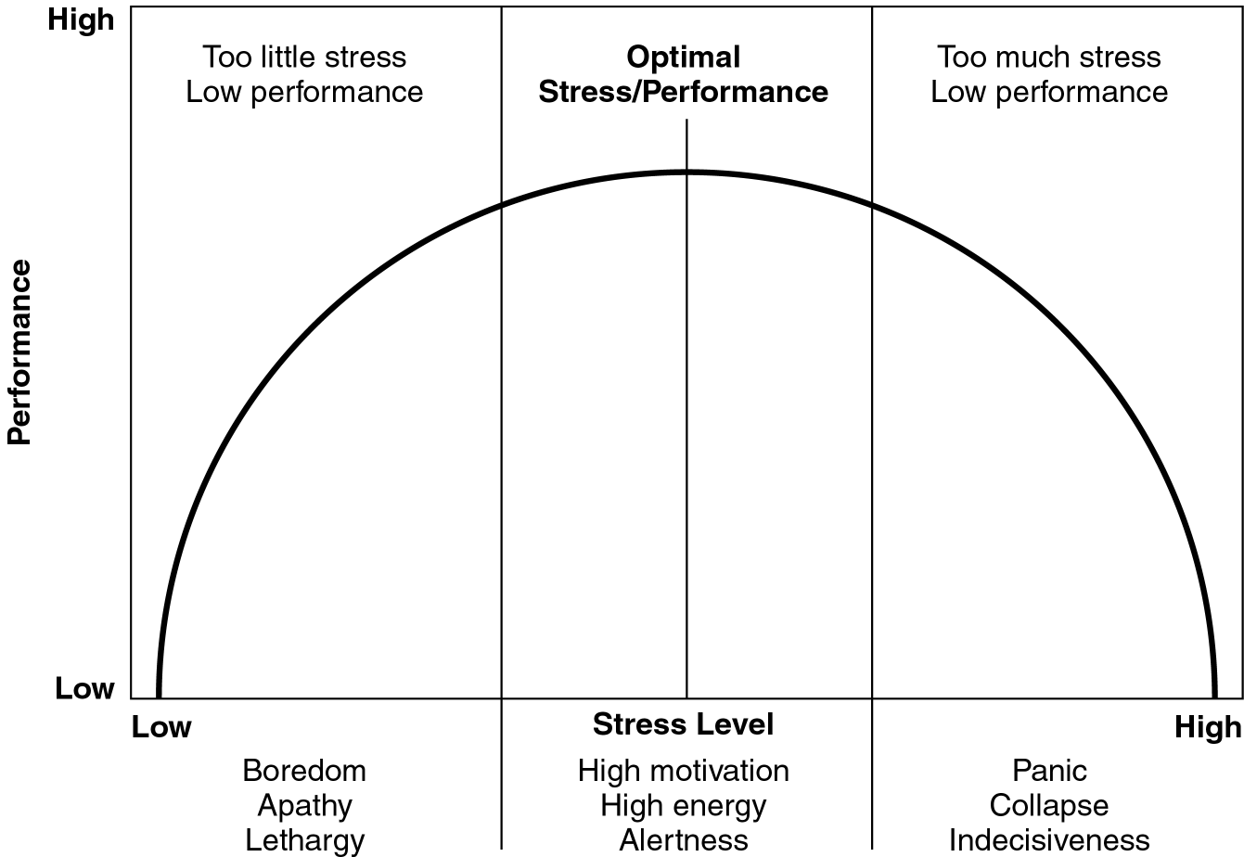
Relationship Between
Stress and Job Performance

Slide 27
Stress Management Tips
Change your environment so that the demands are not so high (eg. job change).
Learn how to better cope with your environment.
Learn to relax.
Shift your outlook so that you can look at situations in a more positive way.
Cultivate a supportive social circle.

Slide 28
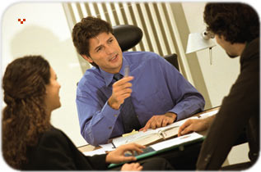
Stress Management Techniques
Self-understanding
Cognitive therapy
Self-management (becoming better-organized)
Conflict resolution
Positive attitude
Self-talk

Slide 29
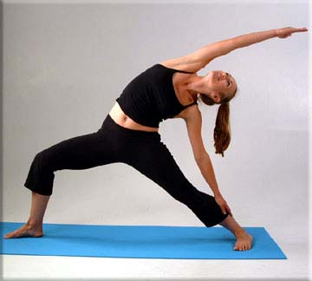
Stress Management Techniques
Hypnosis
Yoga
Relaxation music
Exercise
Healthy eating
Rest/sleep
Stress balls

Slide 30
Relax Music ♫ Appreciation
~ 10 mins

Slide 31
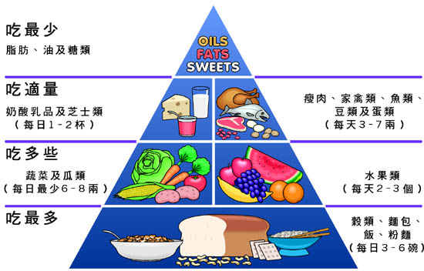
Healthy eating

Slide 32
Apples
An apple a day…
Cholesterol 膽固醇
Diabetes

Slide 33
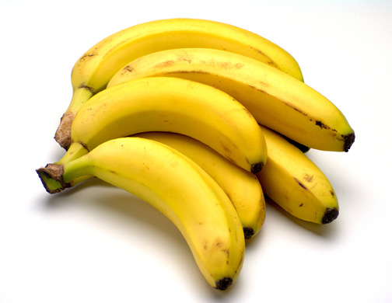
Bananas
Potassium Punch
Cardiovascular 心血管 Health
Intestinal Protection
Tryptophan色氨基酸 – stress reducer

Slide 34
Barley 大麥
Soluble fiber for heart health
Protease inhibitors fight cancer
Great filler

Slide 35
Broccoli
Fights stomach and colon cancer
Fights lung cancer among smokers
Vitamin C
Calcium
Potassium

Slide 36
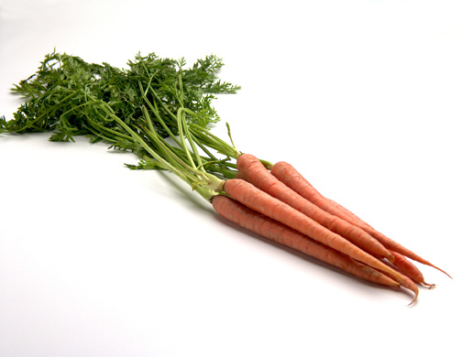
Carrots
Fights lung cancer
No smoking!
Cooked is better

Slide 37
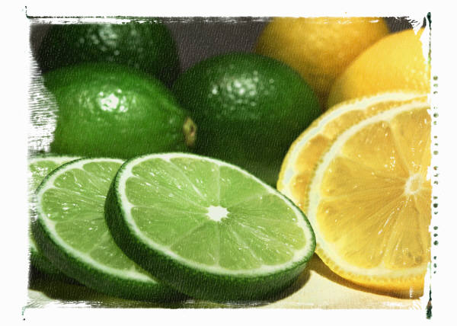
Citrus Fruits
Loaded with vitamin C
Reduce cancer risk
Boost immune system
Healthy gums
Wound healing
Red blood cells

Slide 38
Figs 無花果
A sweet treat with benefits
Reduces cholesterol
Promotes fullness
Benzaldehyde fights cancer
Combats PMS sugar cravings
More calcium than milk
More potassium than bananas

Slide 39
Fish
Omega-3 Fatty Acids
Reduce cholesterol
Prevent inflammation 發炎
Improved memory
Increased alertness
Enhanced relaxation

Slide 40
Other Beneficial Foods
Garlic
Legumes 豆科食物
Nuts
Olive Oil
Tomatoes
Yogurt

Slide 41
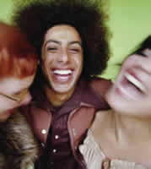
Stress Management Techniques
Breathing exercises
Progressive relaxation
Meditation
Therapeutic massage
Laughter
Sexual intercourse

Slide 42
Other Individual Coping Strategies to Reduce Stress
Capitalize on Your Productivity Cycle
Avoid Procrastinating
Minimize Disruptions
Meeting Management
Delegate

Slide 43
Time Management to Reduce Stress
Constantly Ask:
What is the
most effective use of my time right now?

Slide 44
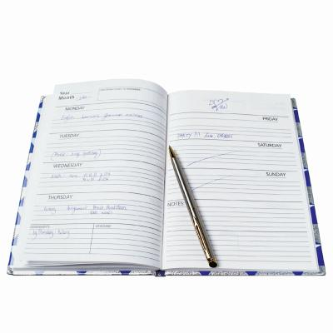
Time Management
Setting priorities can help reduce anxiety.
Using a "to do" list of tasks that can give a person a sense of control and accomplishment.
Effective stress management involves learning to set limits and to say "No" to some demands that others make.

Slide 45
Methods for Dealing with Procrastination
ENVIRONMENTAL REASONS POTENTIAL SOLUTIONS
Unpleasant task Do it first thing.
Find someone else to do it.
Overwhelming tasks Divide and conquer by breaking it into smaller pieces.
Ride the momentum.
Once you get going, keep at it.
Unclear task flow Ask for clarification.
Plan how to do it yourself.

Slide 46
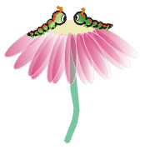
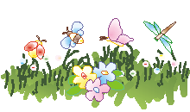
Don’t Worry, Be Happy.

Slide 47
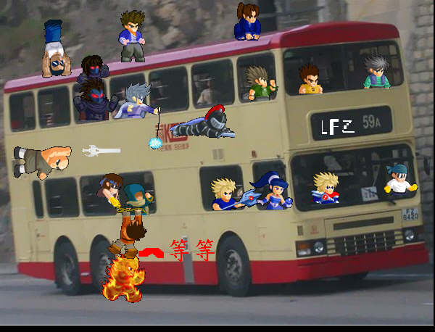
The end

